Slide 1
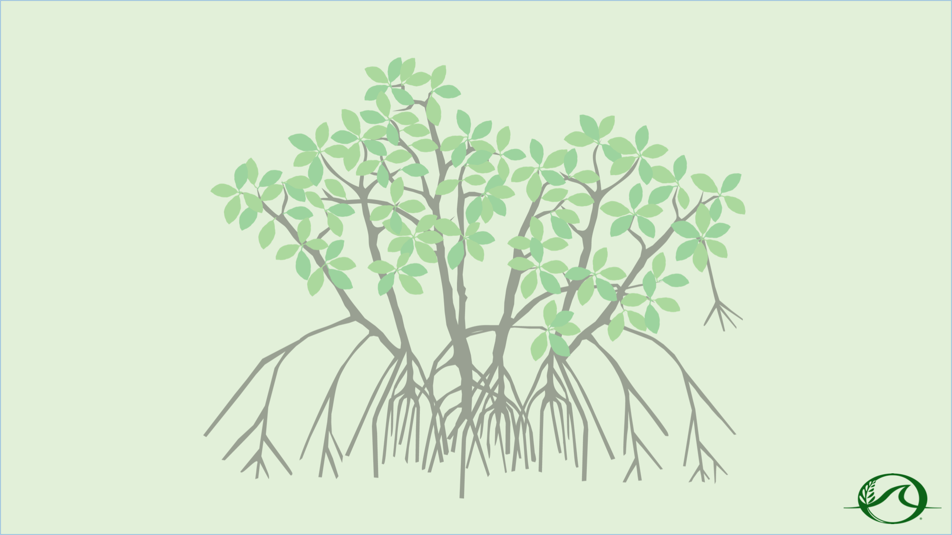
Part 1:
What is Disease?
North Carolina State University
PhD Candidate, Ryann Rossi
Khaled bin Sultan Living Oceans Foundation
Director of Education, Amy Heemsoth, M.Sci.
FRIENDS of the Environment
Education Officer, Cassandra Abraham

Slide 2
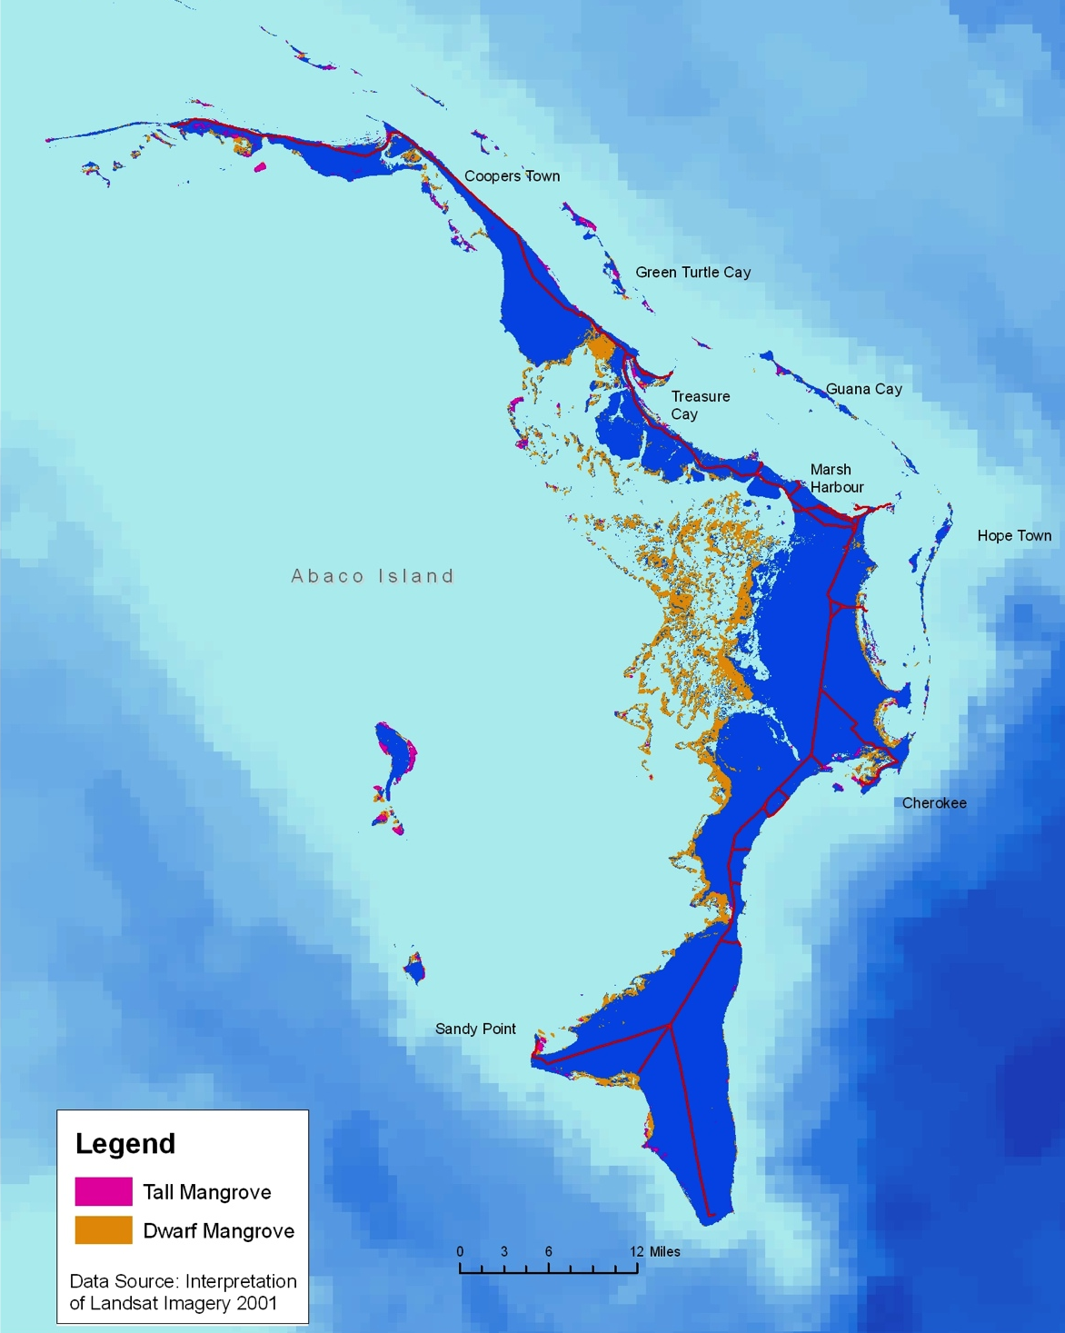
Mangrove Disease
Disease: a condition of a plant or animal that impairs normal body structure or function.
The Marls

Slide 3
What is Microbiology?
Microbiology
’Micro-’ = small + ‘-Bio-’ = life + ‘-Ology’ = the study of
Microbiology: The study of microscopic organisms.
Notes:
Image: By Pinpin 08:35, 26 May 2006 (UTC) (Own work, made with the Gimp) [CC-BY-SA-2.5 (http://creativecommons.org/licenses/by-sa/2.5), GFDL (http://www.gnu.org/copyleft/fdl.html) or CC-BY-SA-3.0 (http://creativecommons.org/licenses/by-sa/3.0/)] 16 Apr 2014 via Wikimedia Commons. http://upload.wikimedia.org/wikipedia/commons/9/95/World_map_mangrove_distribution.png.

Slide 4
Cause of Plant Disease
    Pathology
    ‘Path-’ = suffering and ‘–Ology’ the study of.
  Pathology: The study of diseases.
The main causes of plant disease is from pathogens.
  Pathogens: infectious agents
Notes:
Image: By Pinpin 08:35, 26 May 2006 (UTC) (Own work, made with the Gimp) [CC-BY-SA-2.5 (http://creativecommons.org/licenses/by-sa/2.5), GFDL (http://www.gnu.org/copyleft/fdl.html) or CC-BY-SA-3.0 (http://creativecommons.org/licenses/by-sa/3.0/)] 16 Apr 2014 via Wikimedia Commons. http://upload.wikimedia.org/wikipedia/commons/9/95/World_map_mangrove_distribution.png.

Slide 5
Main Types of Plant Pathogens
There are four main types of plant pathogens (though there are others):
  Fungus (plural fungi): eukaryotic organisms that includes unicellular microorganisms such as yeast, mold, and mushrooms. They are classified in the Kingdom Fungi.
  Bacterium (plural bacteria): Prokaryotic microorganisms or unicellular organism in the Domain Bacteria. Most bacteria are beneficial; however, some are harmful.
  Virus: A small infectious agent that replicates inside a living organism.
  Nematode: Roundworms that are classified in the phylum Nematoda.

Slide 6
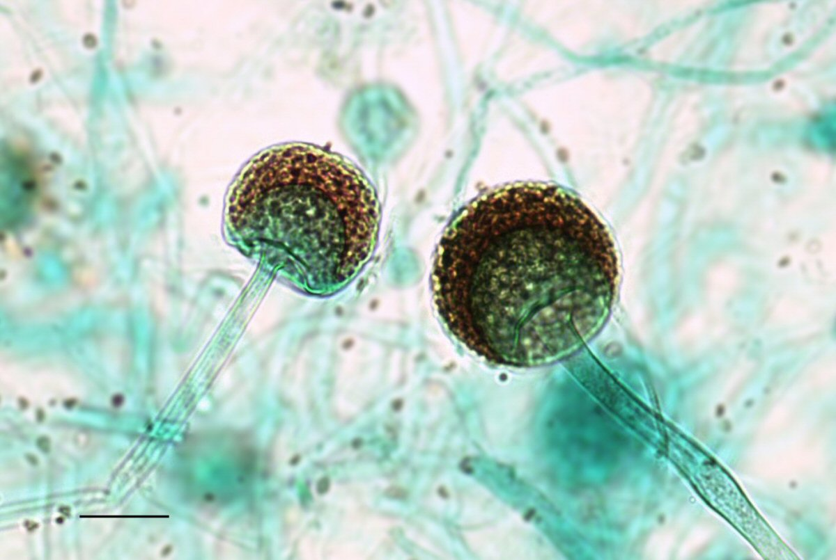
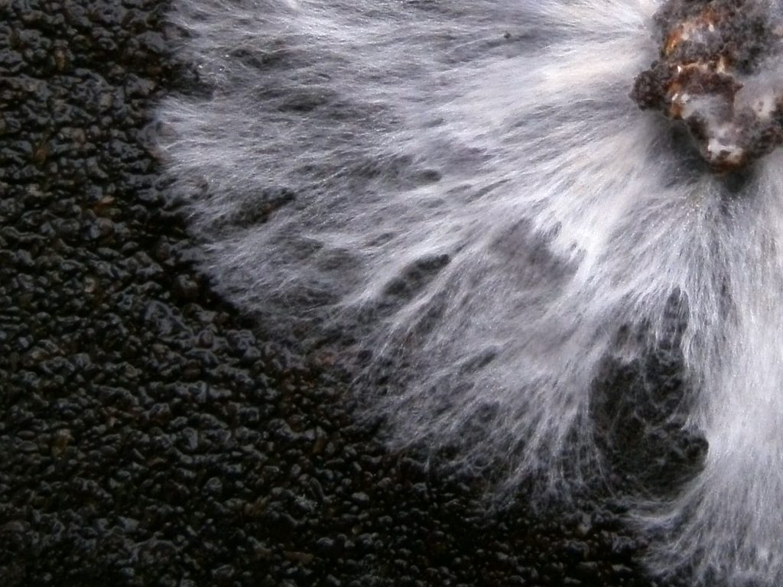
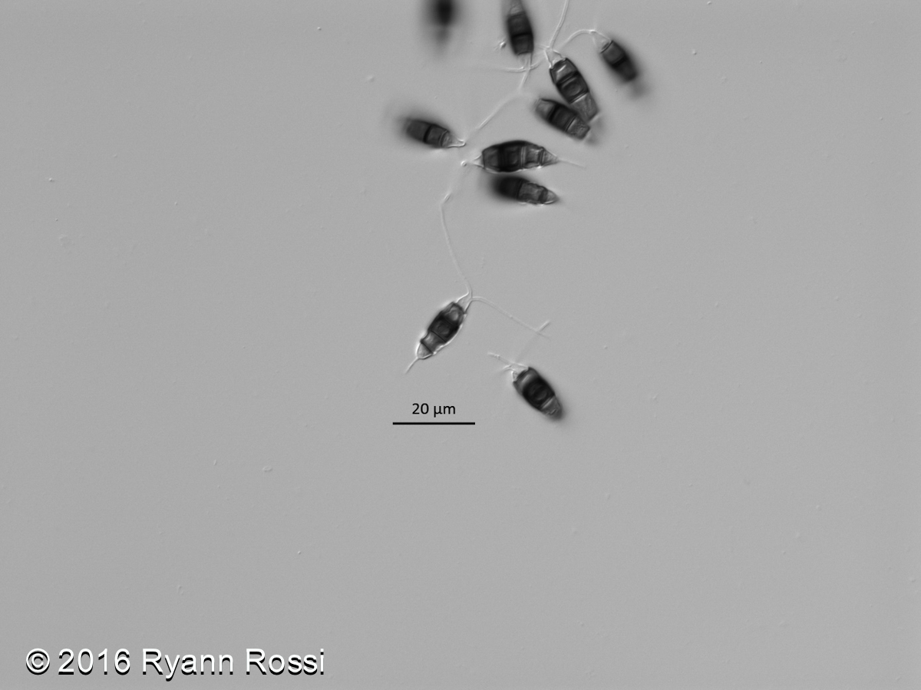
Structure of Fungi
Identifying Structures:
  Hypha (plural hyphae): Branching filaments that make up the mycelium.
  Spore: Reproductive structures.
  Mycelium (plural mycelia): A network of branching hyphae.
Mycelium
Spore
Hypha
Spore
Notes:
Microscope Aqua Image: By Jon Houseman (Jon houseman and Matthew Ford) [CC BY-SA 3.0 (http://creativecommons.org/licenses/by-sa/3.0)], 13 May 2014 via Wikimedia Commons. https://upload.wikimedia.org/wikipedia/commons/e/ed/Zygo1000.jpg.
White Fungus: By Tobi Kellner (Own work) [CC BY-SA 3.0 (http://creativecommons.org/licenses/by-sa/3.0)], 10 February 2012 via Wikimedia Commons. https://upload.wikimedia.org/wikipedia/commons/3/31/Oyster_mushroom_%28Pleurotus_ostreatus%29_mycelium_in_petri_dish_on_coffee_grounds.JPG.

Slide 7
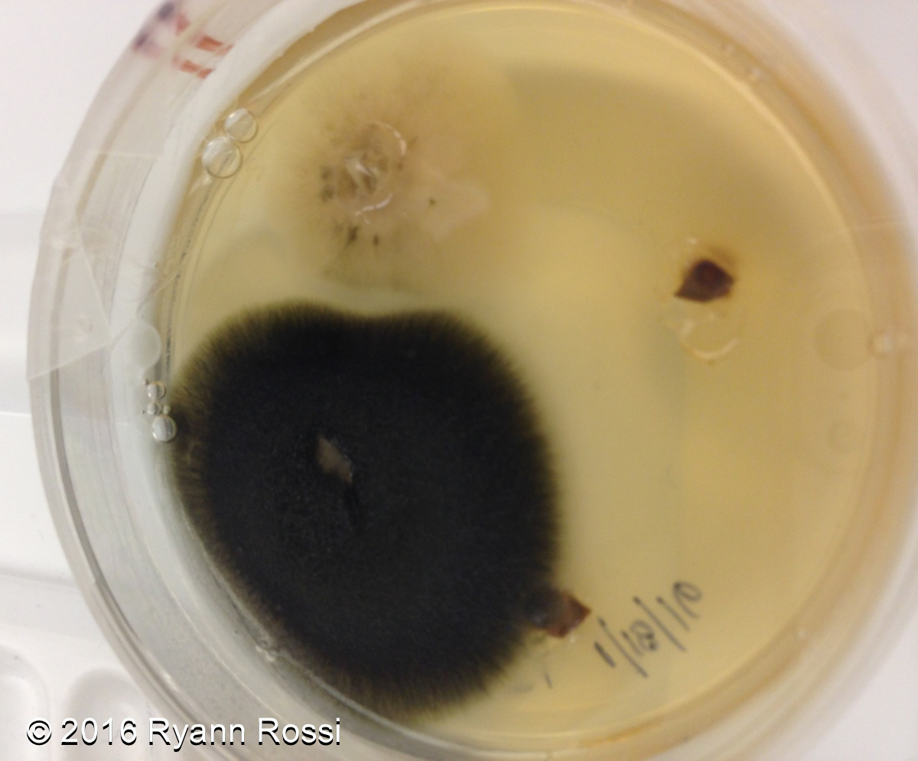
Identifying Bacteria
Bacterial Contamination

Slide 8
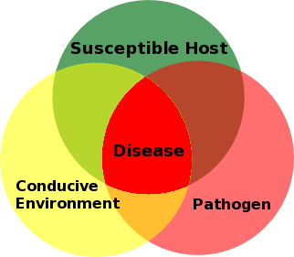
What is Needed for Disease to Occur?
Notes:
^{Attributions}
Plant Disease Triangle By Earlycj5 (Own work) [CC BY-SA 3.0 (http://creativecommons.org/licenses/by-sa/3.0)], 25 February 2008 via Wikimedia Commons. https://commons.wikimedia.org/wiki/File%3APlant_Disease_Triangle.png.

Slide 9
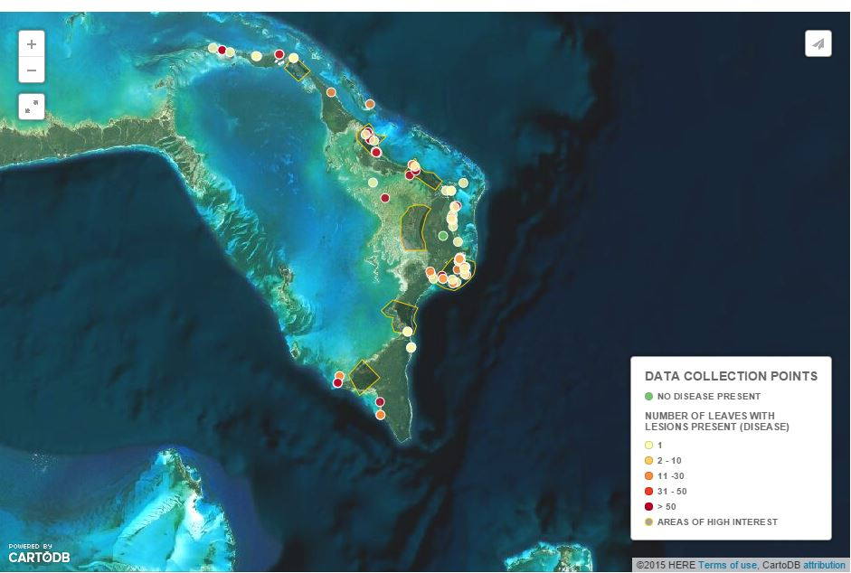
Mangrove Disease in the Bahamas

Slide 10
Field Data Instructions
Look for diseased leaves in a 5 x 5 meter squared area. Each person needs to collect 1 leaf.
Record data in Table A of your student worksheet.
  GPS position
  Observations
  Visual survey (0, 1, 2-10, 11-30, 31-50, or > 50 leaves)
  Note dead trees in 5 x 5 meter squared area
Store leaf in Ziploc bag. Label the bag with the date and Sample Leaf number.

Slide 11
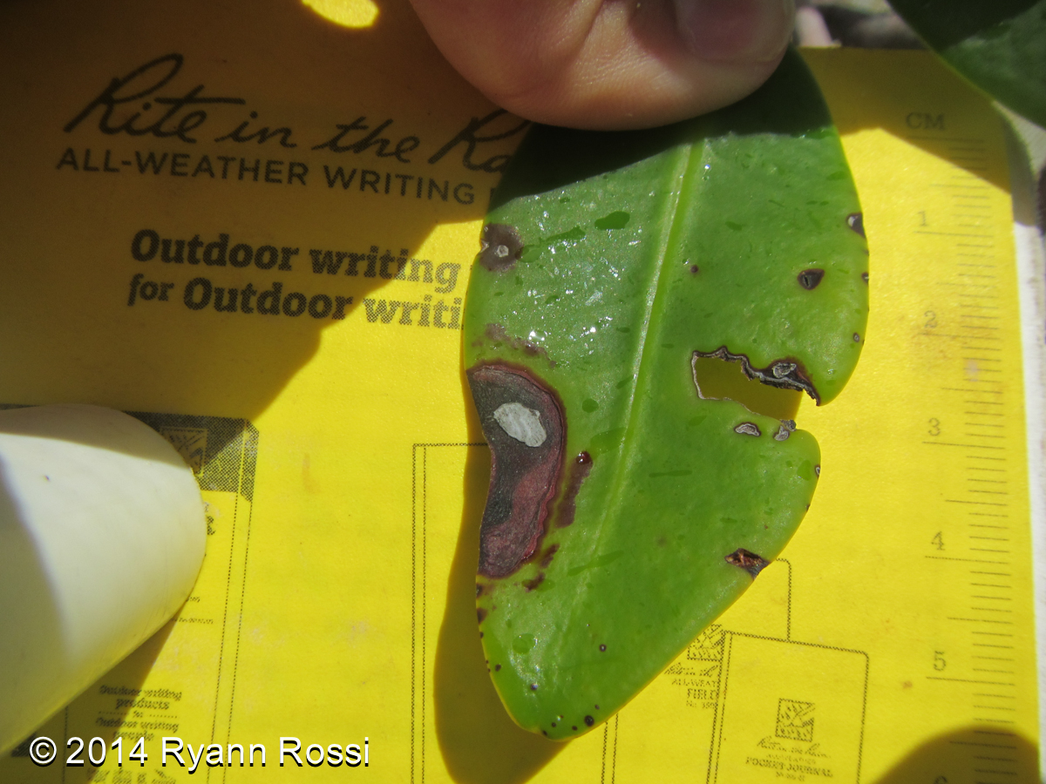
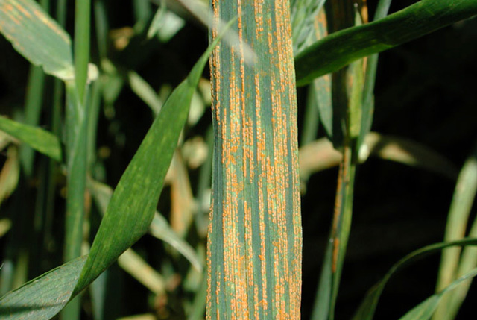
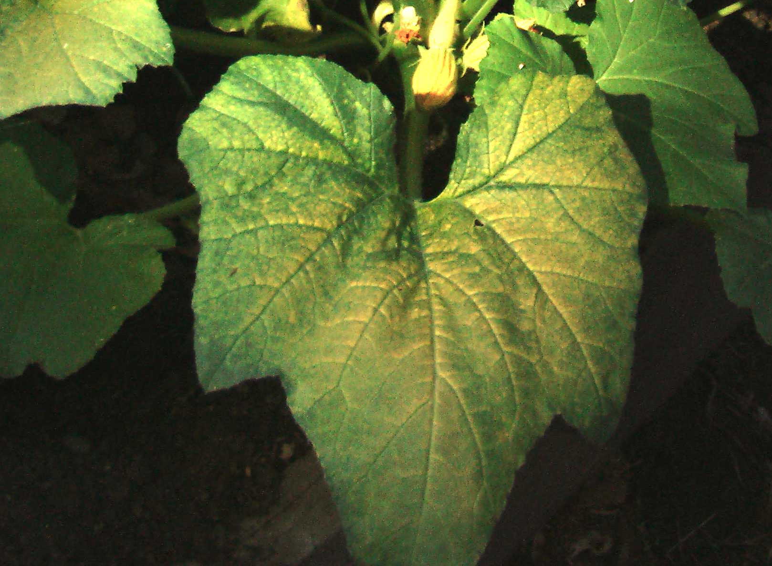
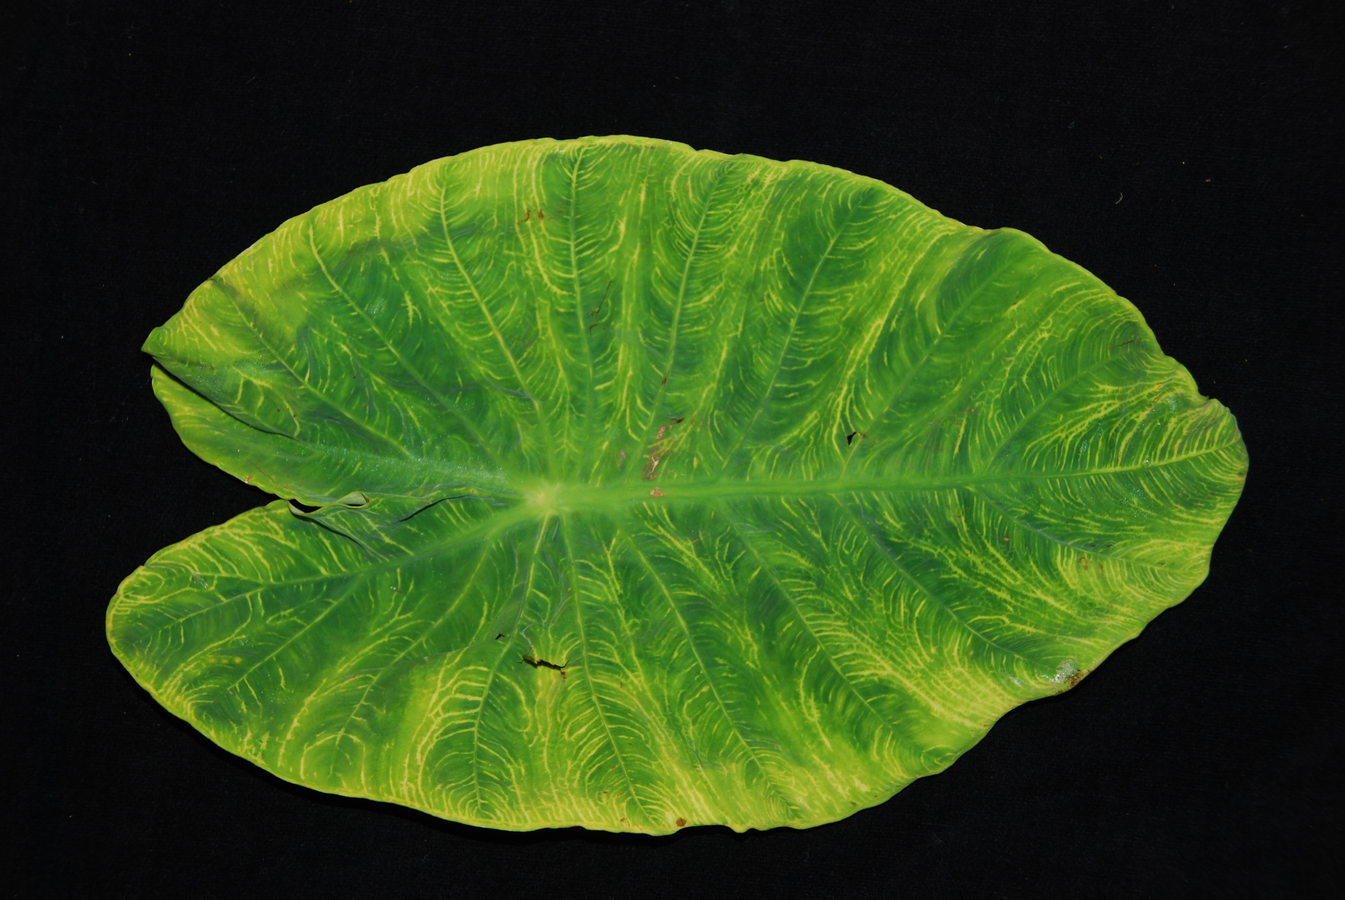
Mangrove Disease Activity
What do Diseased Mangrove Leaves Look Like? Some common symptoms are:
Necrotic Tissue
Discolored Veins
Yellowing Tissue
Striping Appearance
Notes:
Striping: Photo by Yue Jin. [http://www.ars.usda.gov/is/graphics/photos/jun06/d517-1.htm Image Number D517-1] {{PD-USGov-USDA-ARS}} 26 September 2006 via Wikimedia Commons. https://commons.wikimedia.org/wiki/File:Stripe_rust_on_wheat.jpg#file.
Yellowing: By Babahu [CC0],13 June 2012 via Wikimedia Commons. https://upload.wikimedia.org/wikipedia/commons/b/b7/Yellow_Mosaic_Virus_on_yellow_squash_leaf.jpg.
Discolored Veins: Taro Vein chlorosis By Scot Nelson [CC By-NC-SA 2.0 (https://creativecommons.org/licenses/by-nc-sa/2.0/)], June 2013 via Flickr. https://www.flickr.com/photos/scotnelson/8981028008/.

Slide 12
Adaptation – Reproduction Continued
Part 2:
Mangrove Isolations
RED | BLACK | WHITE
Pale yellow flowers | White flowers | Greenish-yellow flowers
Viviparous propagules | Viviparous propagules | Semi-viviparous propagules
Look like giant green beans | Flattened, bean-shaped | Pea-green, flattened, almond-shaped
up to 30 cm | 2-3 cm | Less than 2.5 cm
North Carolina State University
PhD Candidate, Ryann Rossi
Khaled bin Sultan Living Oceans Foundation
Director of Education, Amy Heemsoth, M.Sci.
FRIENDS of the Environment
Education Officer, Cassandra Abraham

Slide 13
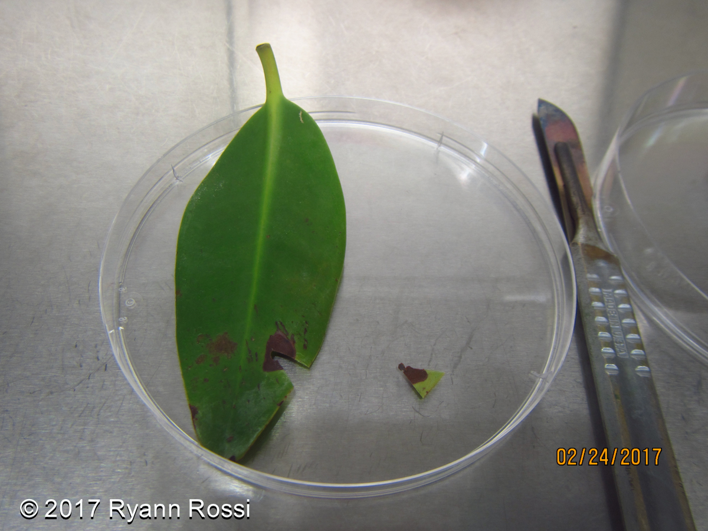
Sample Size
Cut the leaf into two small pieces at the margin of the lesion and green leaf.

Slide 14
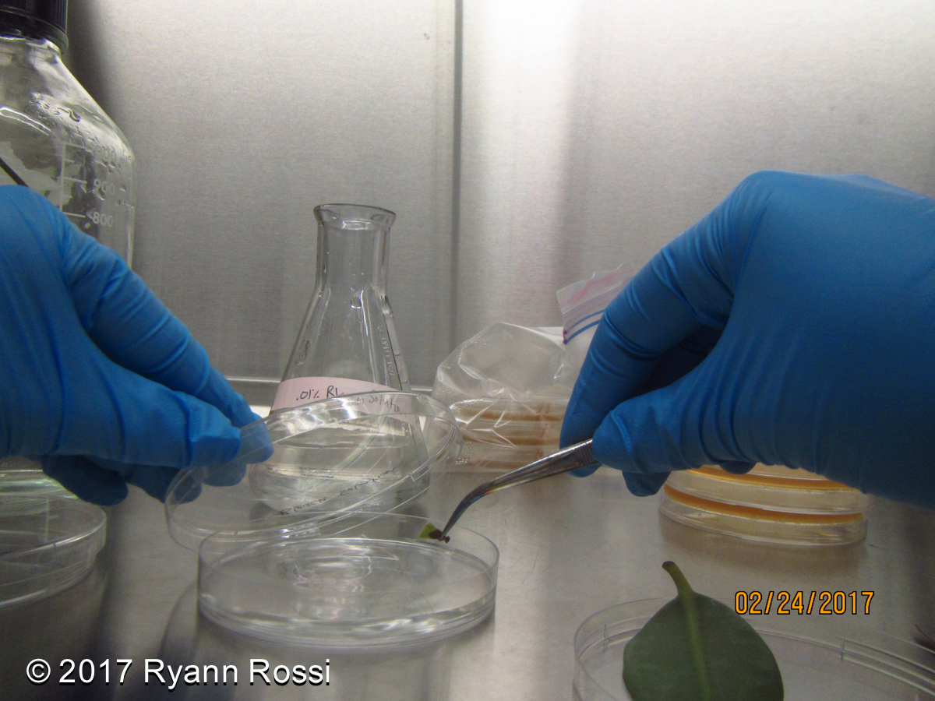
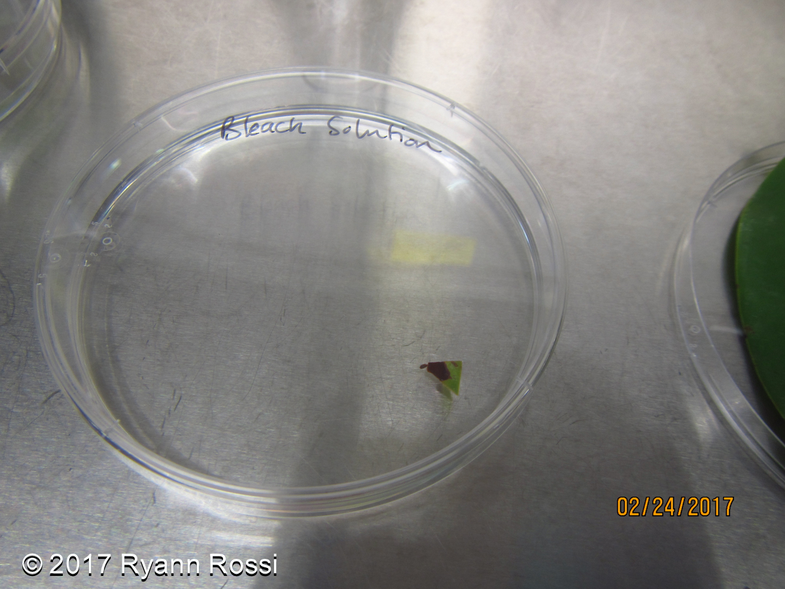
Leaf Sterilization
Sterilize leaf pieces by placing them into a bleach solution for 1 minute.
Notes:
Photo Source: AGU American Geophysical Union http://www.oceanhealthindex.org/Components/Mangroves/

Slide 15
Sterilize Tweezers
If you are not wearing gloves, sterilize your hands with hand sanitizer.
While leaf pieces are sterilizing, sterilize tweezers with alcohol and flame for 5 seconds.

Slide 16
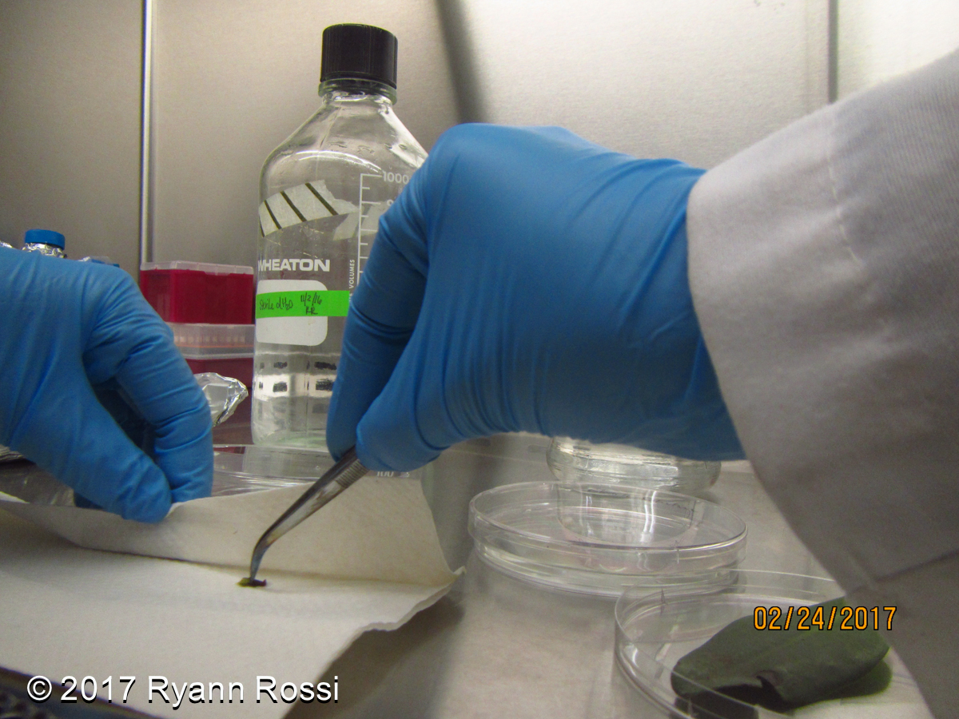
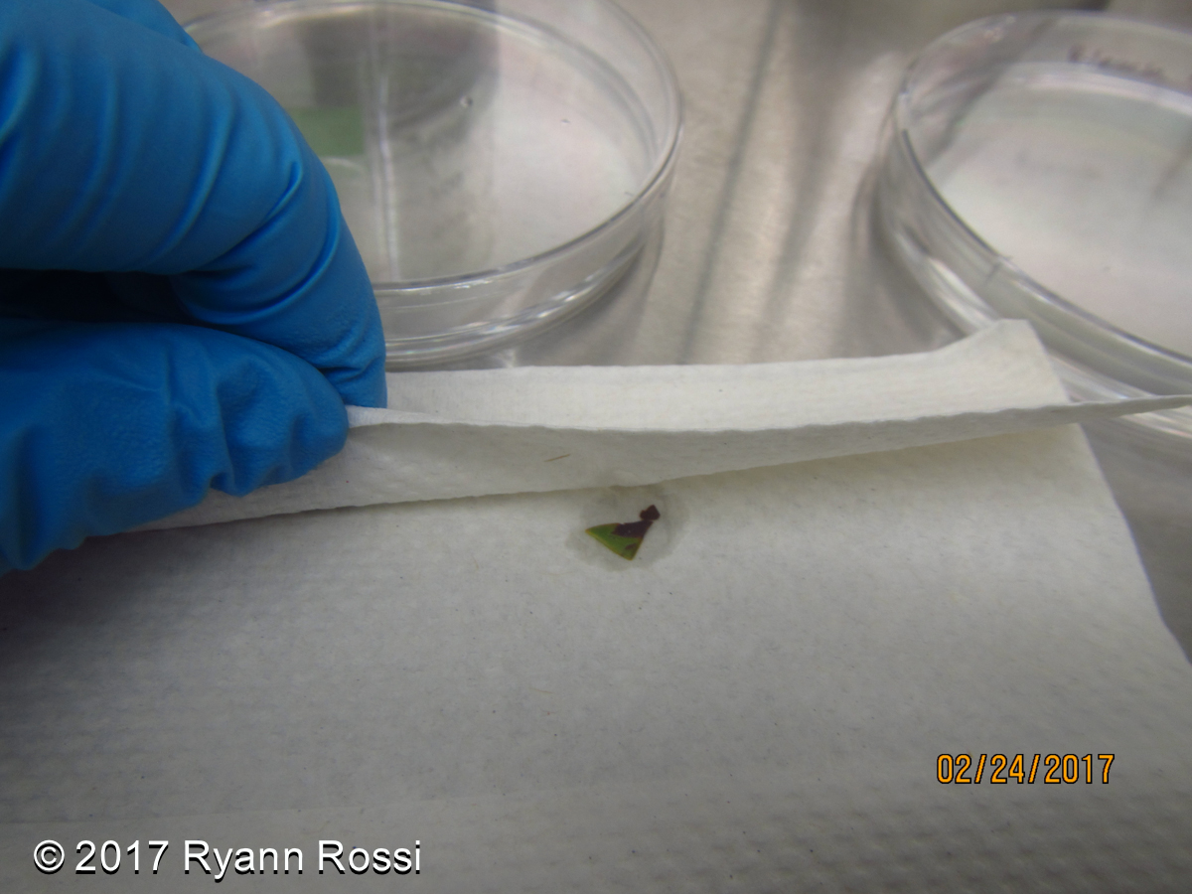
Dry Leaf Pieces
Remove one paper towel from the foil.
Use tweezers to transfer leaf pieces to paper towel and dab dry.

Slide 17
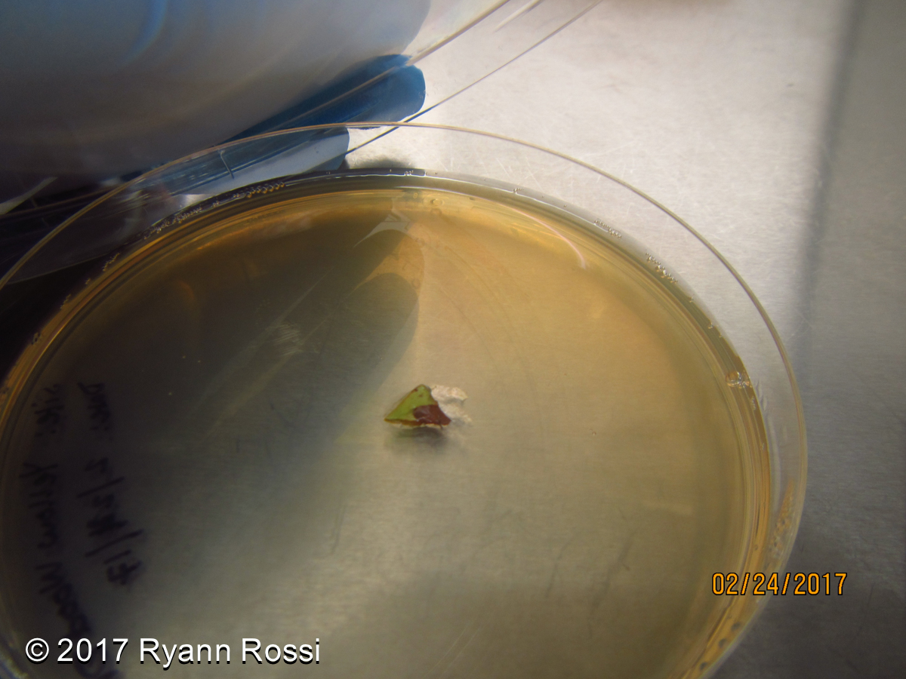
Insert Leaf Pieces into Agar
Use sterile tweezers to place leaf on the PDA agar in the petri dish.

Slide 18
Seal Petri Dish
Close the petri dish lid and wrap it with saran wrap to help prevent contamination.

Slide 19
Part 3:
Sample Analysis
North Carolina State University
PhD Candidate, Ryann Rossi
Khaled bin Sultan Living Oceans Foundation
Director of Education, Amy Heemsoth, M.Sci.
FRIENDS of the Environment
Education Officer, Cassandra Abraham

Slide 20
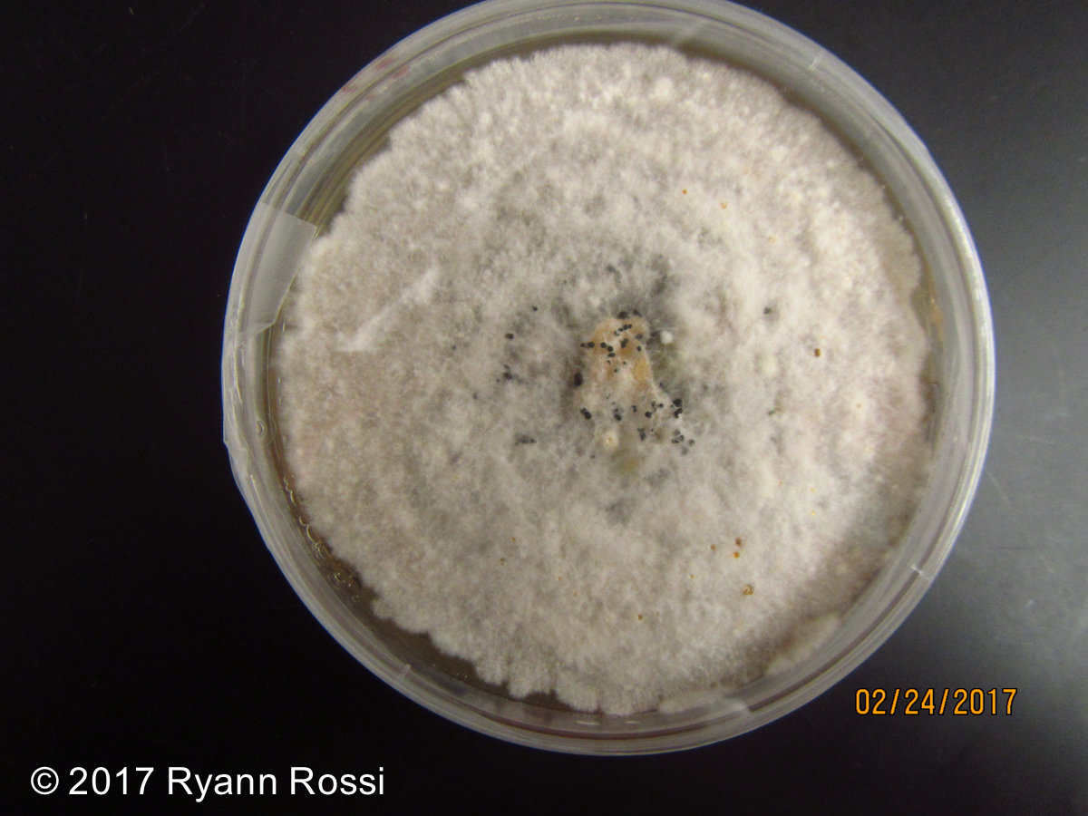
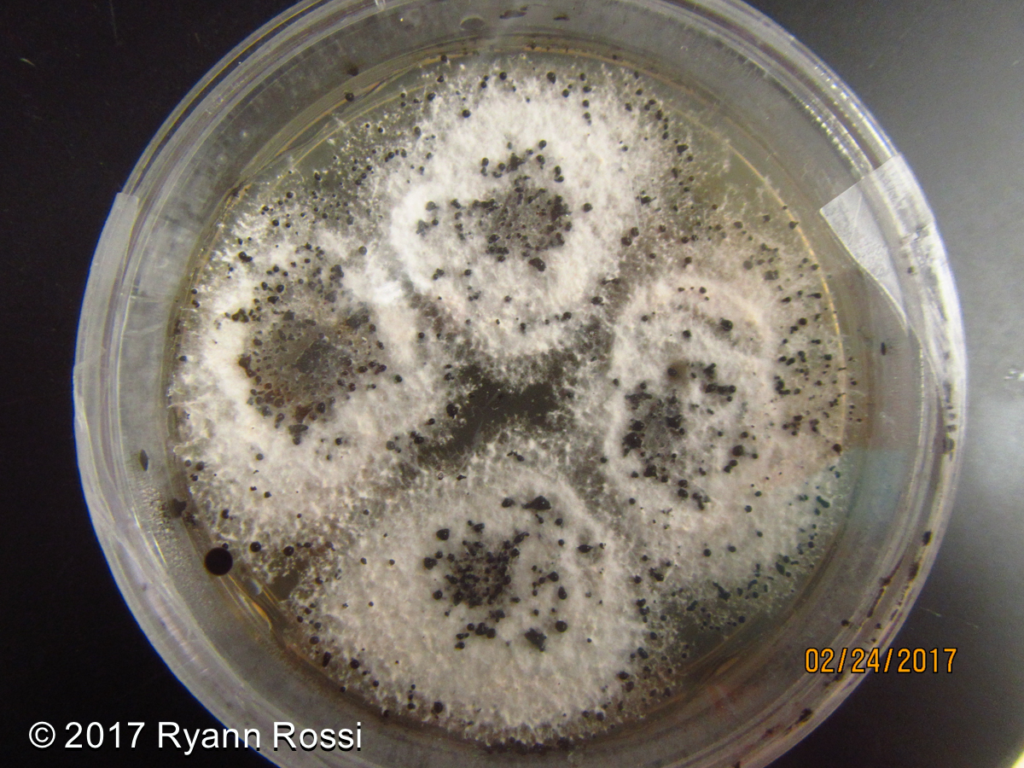
Pestalotiopsis
White, fluffy fungal colonies; sometimes black dots on top

Slide 21
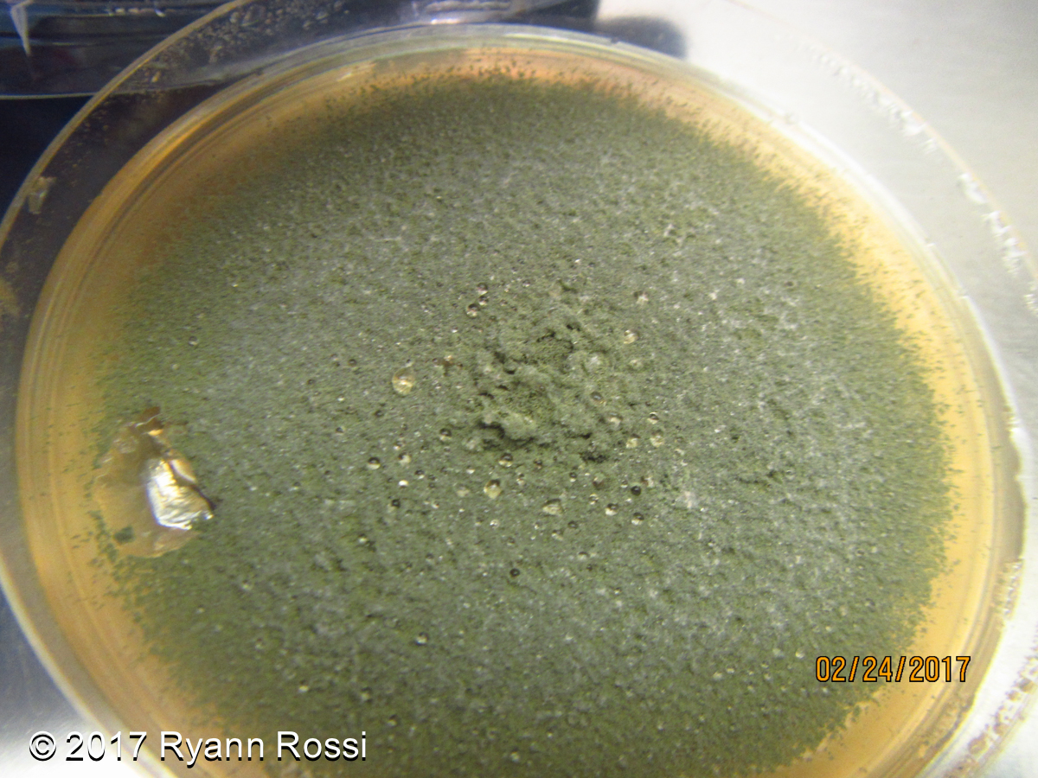
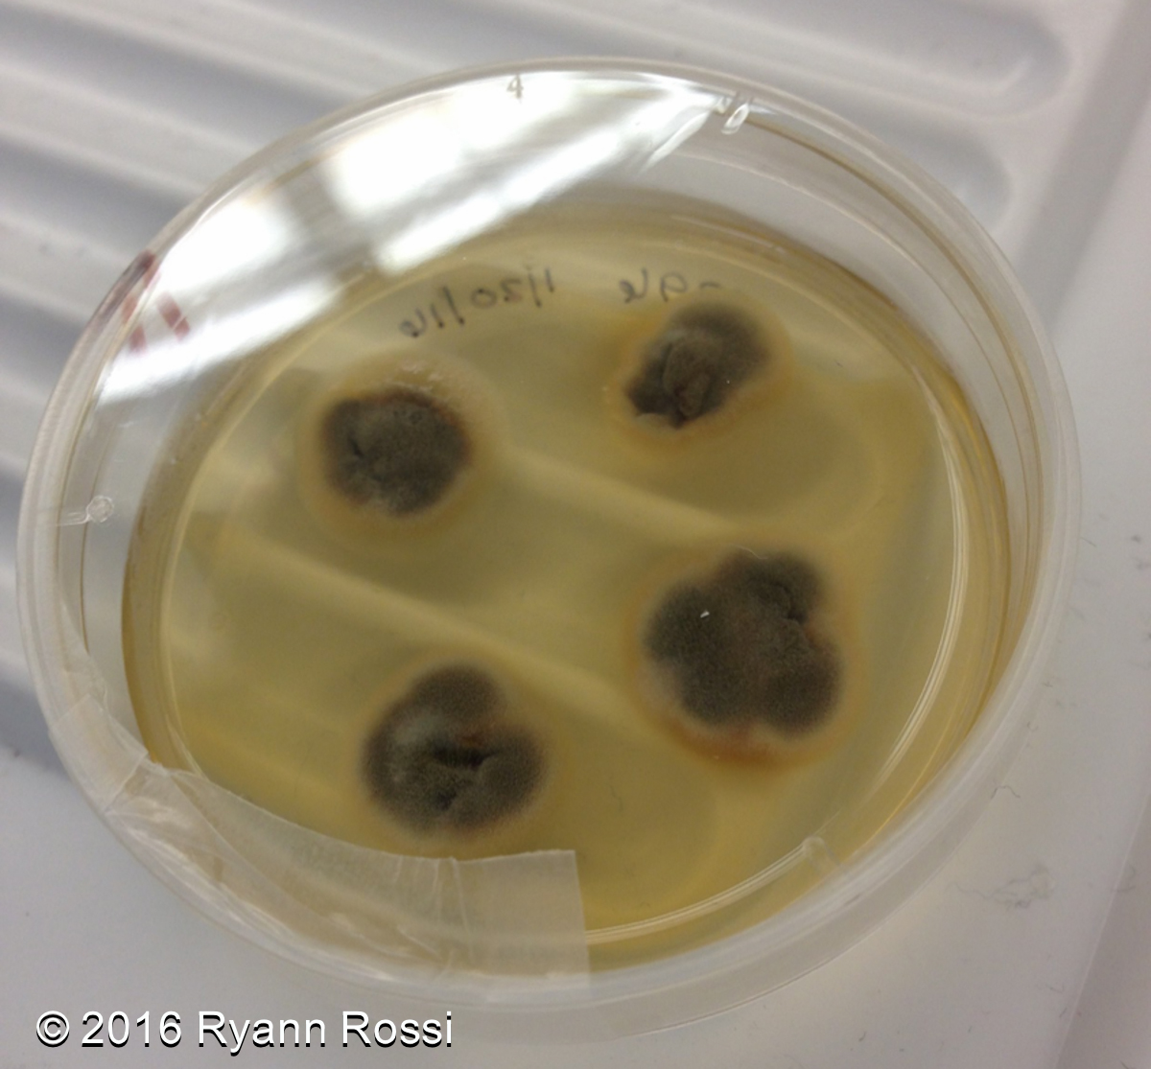
Penicillium
Olive green and densely packed fungal colonies

Slide 22
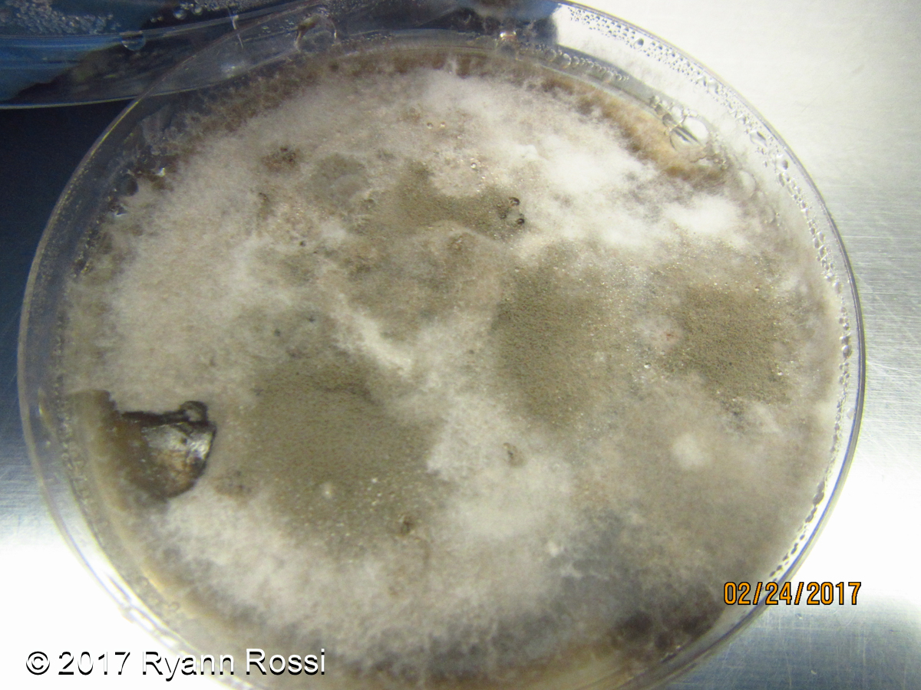
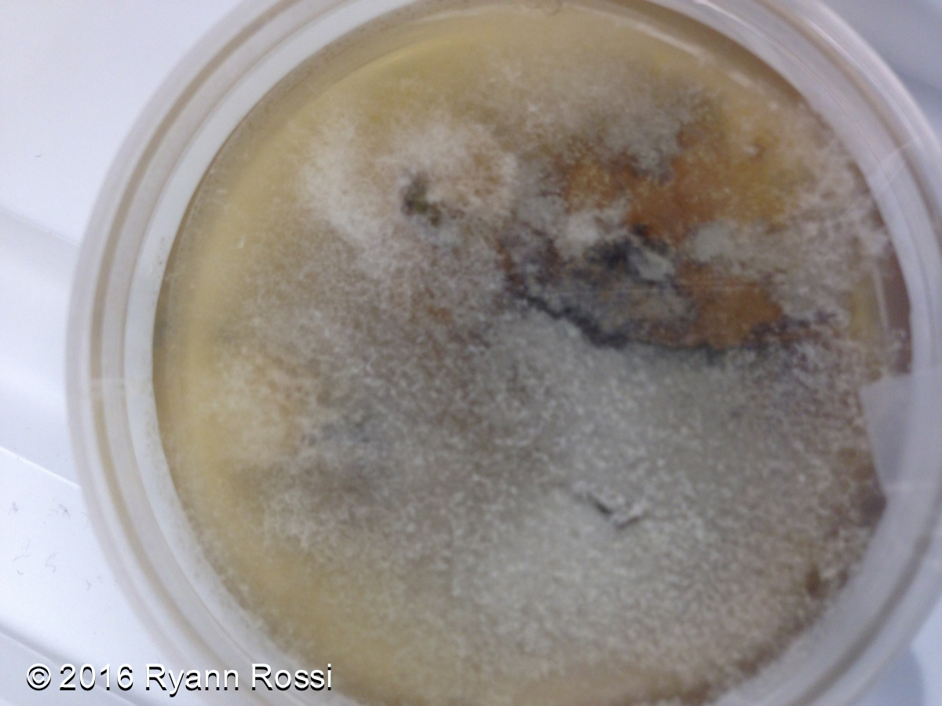
Unknown Colony
Light gray and fluffy fungal colonies

Slide 23
Bacterial Contamination
Bacterial Contamination

Slide 24
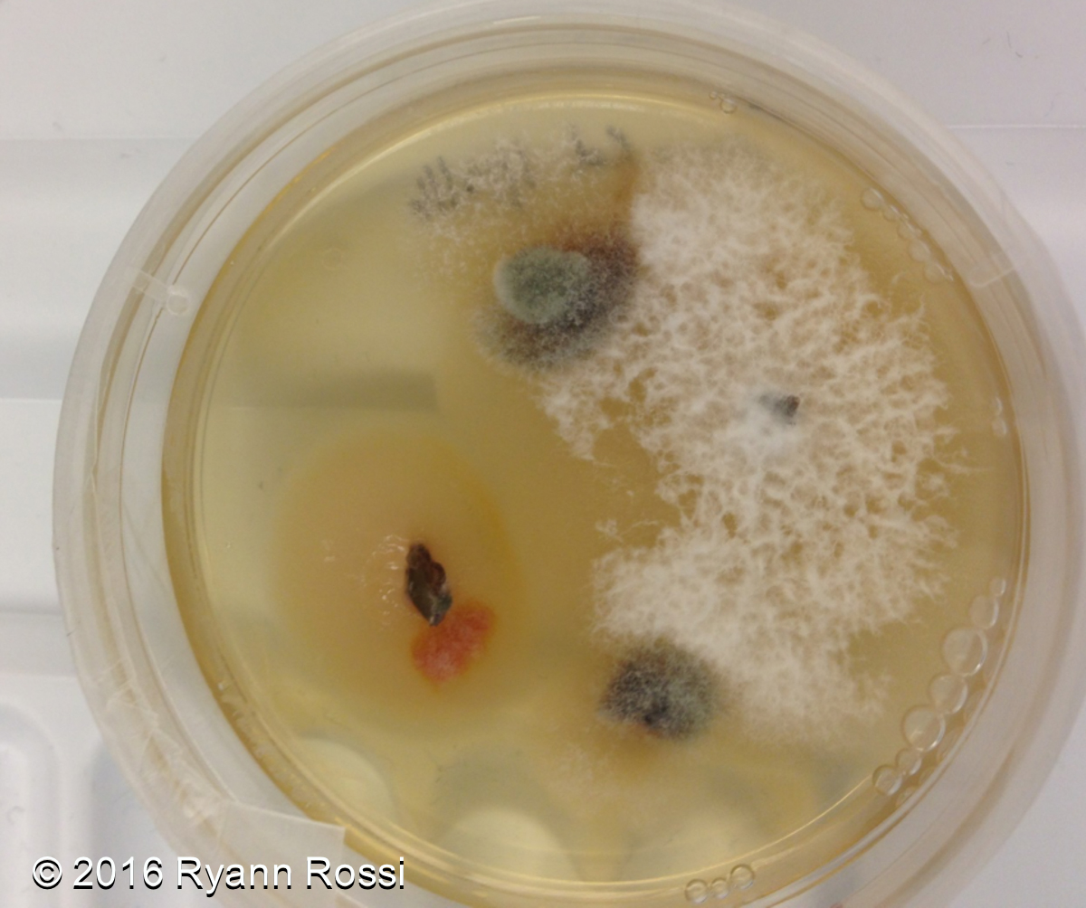
Practice Identification 1
Penicillium
Pestalotiopsis
Bacterial Contamination

Slide 25
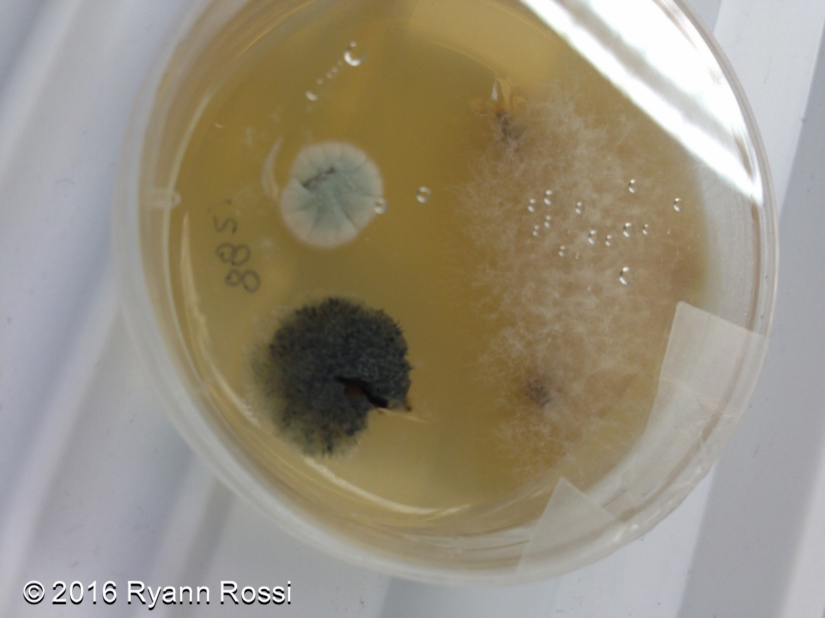
Practice Identification 2
Penicillium
Pestalotiopsis
Bacterial Contamination

